Slide 1
KIDNEY STONE PREDICTION BY USING A SUPERVISED MACHINE LEARNING TECHNIQUE
HEMANTH R A
KISHORE KUMAR A
KAVITHA V
PAPER ID – RIST23-1159

Slide 2
Abstract:
Kidney stones are mineral deposits in the renal calyces and pelvis that are found free or attached to the renal papillae. They contain crystalline and organic components and are formed when the urine becomes supersaturated with respect to a mineral.
Calcium oxalate is the main constituent of most stones, many of which form on a foundation of calcium phosphate called Randall’s plaques, which are present on the renal papillary surface.
Researchers apply several data mining and machine learning techniques to analyze huge complex medical data, helping healthcare professionals to predict kidney stones.
The proposed method is to build a machine learning model capable of classifying whether a person has a kidney stone or not. Different algorithms are compared and the best model is used for predicting the outcome

Slide 3
Existing System:
An accurate estimation of glomerular filtration rate (GFR) is clinically crucial for kidney disease diagnosis
Predicting the prognosis of chronic kidney disease (CKD).
Deep neural networks provide a potential avenue for increasing accuracy in GFR estimation.
A novel deep learning architecture, a deep and shallow neural network, to estimate GFR.

Slide 4
Proposed System:
The proposed method is to build a machine learning model for classification of Kidney stone. The process carries from data collection where the past data related to Kidney stone are collected.
The Kidney stone if found before proper treatment can save lives
The proper machine learning algorithm is applied on the dataset where the pattern of data is learned. After applying different algorithms a better algorithm is used for the prediction of the outcome.

Slide 5
Machine Learning:
Machine learning is to predict the future from past data. Machine learning (ML) is a type of artificial intelligence (AI) that provides computers with the ability to learn without being explicitly programmed. Machine learning focuses on the development of Computer Programs that can change when exposed to new data and the basics of Machine Learning, implementation of a simple machine learning algorithm using python. Process of training and prediction involves use of specialized algorithms..
Supervised learning program is both given the input data and the corresponding labeling to learn data has to be labeled by a human being beforehand. Unsupervised learning is no labels. It provided to the learning algorithm. This algorithm has to figure out the clustering of the input data. Finally, Reinforcement learning dynamically interacts with its environment and it receives positive or negative feedback to improve its performance

Slide 6
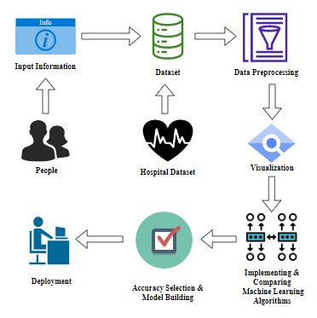
System Architecture:

Slide 7
List of Modules:
Data Pre-processing
Exploratory Data Analysis of Visualization
Implementing Algorithm
Deployment

Slide 8
Data Pre-processing:
Validation techniques in machine learning are used to get the error rate of the Machine Learning (ML) model, which can be considered as close to the true error rate of the dataset.
If the data volume is large enough to be representative of the population, you may not need the validation techniques. However, in real-world scenarios, to work with samples of data that may not be a true representative of the population of given dataset.
To finding the missing value, duplicate value and description of data type whether it is float variable or integer. The sample of data used to provide an unbiased evaluation of a model fit on the training dataset while tuning model hyper parameters.

Slide 9
Exploratory Data Analysis of Visualization:
Data visualization is an important skill in applied statistics and machine learning. Statistics does indeed focus on quantitative descriptions and estimations of data. Data visualization provides an important suite of tools for gaining a qualitative understanding.
This can be helpful when exploring and getting to know a dataset and can help with identifying patterns, corrupt data, outliers, and much more. With a little domain knowledge, data visualizations can be used to express and demonstrate key relationships in plots and charts that are more visceral and stakeholders than measures of association or significance.
Data visualization and exploratory data analysis are whole fields themselves and it will recommend a deeper dive into some the books mentioned at the end.

Slide 10
Algorithms Used
Support Vector Machine
Naive Bayes algorithm
Voting Classifier
Random Forest Classifier

Slide 11
Support Vector Machine:
Support Vector Machine or SVM is one of the most popular Supervised Learning algorithms, which is used for Classification as well as Regression problems. However, primarily, it is used for Classification problems in Machine Learning.
The goal of the SVM algorithm is to create the best line or decision boundary that can segregate n-dimensional space into classes so that we can easily put the new data point in the correct category in the future. This best decision boundary is called a hyperplane.
SVM chooses the extreme points/vectors that help in creating the hyperplane. These extreme cases are called as support vectors, and hence algorithm is termed as Support Vector Machine.

Slide 12
Naive Bayes algorithm:
The Naive Bayes algorithm is an intuitive method that uses the probabilities of each attribute belonging to each class to make a prediction. It is the supervised learning approach you would come up with if you wanted to model a predictive modeling problem probabilistically.
Naive bayes simplifies the calculation of probabilities by assuming that the probability of each attribute belonging to a given class value is independent of all other attributes. This is a strong assumption but results in a fast and effective method.
The probability of a class value given a value of an attribute is called the conditional probability. By multiplying the conditional probabilities togeth er for each attribute for a given class value, we have a probability of a data instance belonging to that class. To make a prediction we can calculate probabilities of the instance belonging to each class and select the class value with the highest probability.

Slide 13
Voting Classifier:
A Voting Classifier is a machine learning model that trains on an ensemble of numerous models and predicts an output (class) based on their highest probability of chosen class as the output. It simply aggregates the findings of each classifier passed into Voting Classifier and predicts the output class based on the highest majority of voting. The idea is instead of creating separate dedicated models and finding the accuracy for each them, we create a single model which trains by these models and predicts output based on their combined majority of voting for each output class.
Voting Classifier supports two types of votings.

Slide 14
Random Forest Classifier:
Forest is a popular machine learning algorithm that belongs to the supervised learning technique. It can be used for both Classification and Regression problems in ML. It is based on the concept of ensemble learning, which is a process of combining multiple classifiers to solve a complex problem and to improve the performance of the model.
As the name suggests, "Random Forest is a classifier that contains a number of decision trees on various subsets of the given dataset and takes the average to improve the predictive accuracy of that dataset." Instead of relying on one decision tree, the random forest takes the prediction from each tree and based on the majority votes of predictions, and it predicts the final output.
The greater number of trees in the forest leads to higher accuracy and prevents the problem of overfitting.

Slide 15
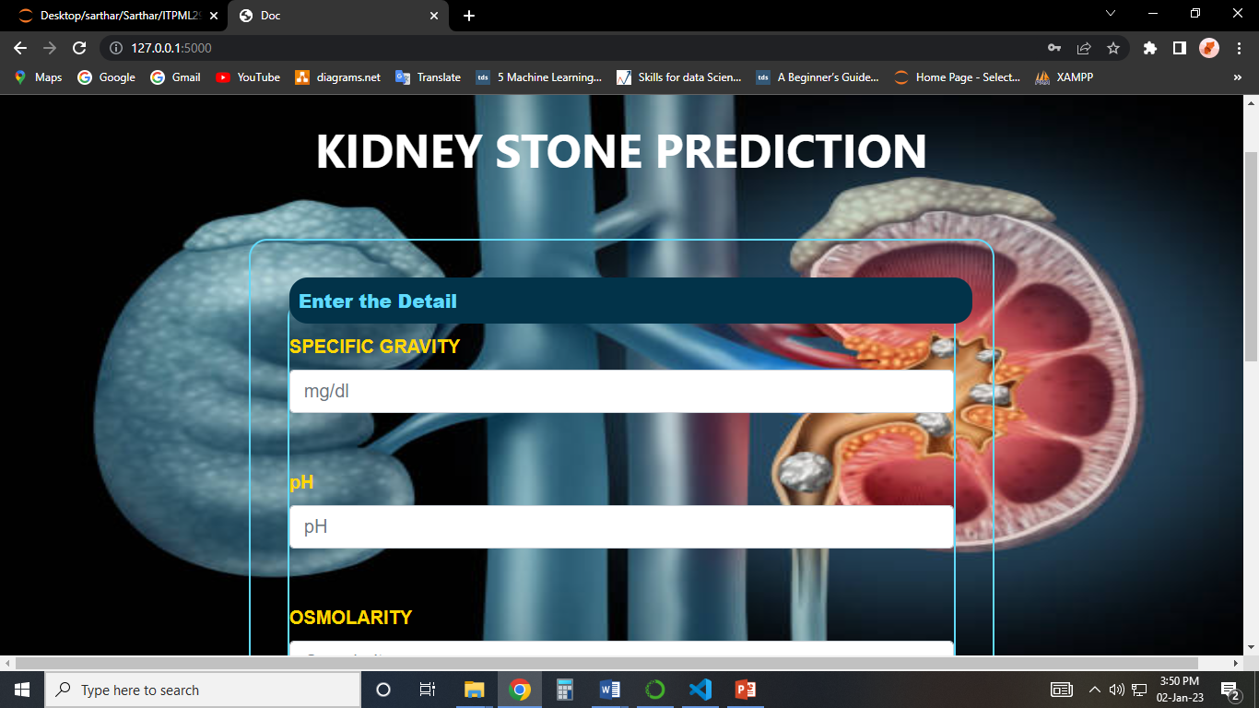
Result:

Slide 16
Conclusion:
The analytical process started from data cleaning and processing, missing values analysis, exploratory analysis and finally model building and evaluation. The best accuracy on public test set is higher accuracy score will be find out. This project can help to find the Prediction of Kidney Stone.
Future Work:
Kidney Stone prediction to connect with Cloud.
To optimize the work to implement in web development

